Slide 1
Climate Change Capstone Presentation
Armand Punjabi

Slide 2
Questions to be addressed
What insights can be drawn from analyzing Global Land Temperature Data?
Can it be determined if the planet is getting warmer?
What areas of the world are seeing the largest increases in temperature?

Slide 3
The Data
Global land temperature data was sourced from Berkley Earth. The data is captured on a monthly basis and segmented by country.
Data was then trimmed to only include years 1913 - 2013, leaving 291,736 rows of data.
All temperature data is measured in degrees Celsius.

Slide 4
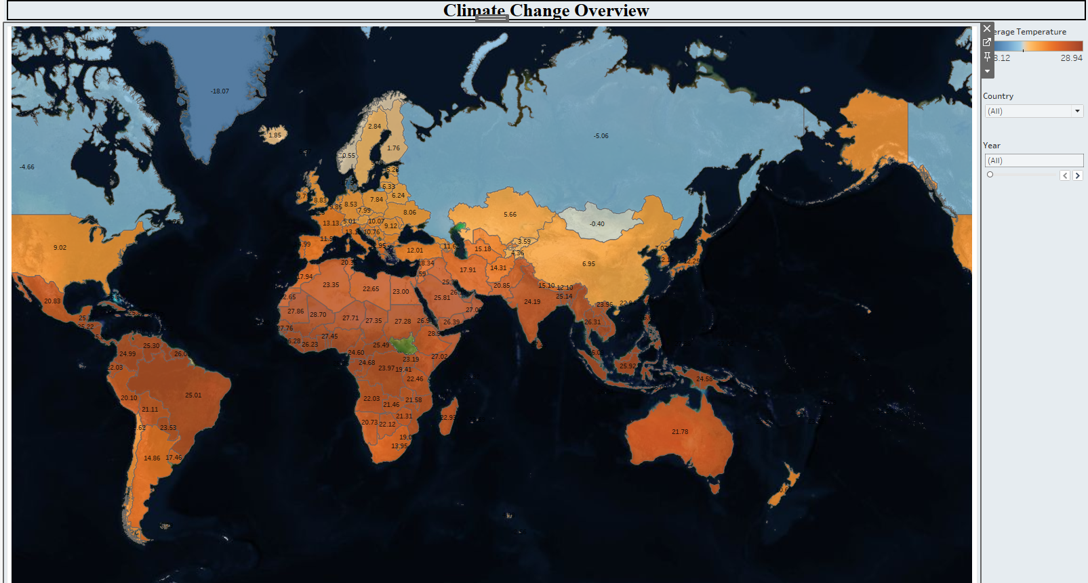
Analysis
Average temperature by country can be visualized on a world map. Temperature is seen on a color scale, with blue being colder and red being warmer.

Slide 5
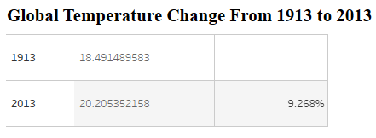
Analysis
As a whole, the planet has seen a 9.268% increase in Global Land temperature from 1913 - 2013!

Slide 6
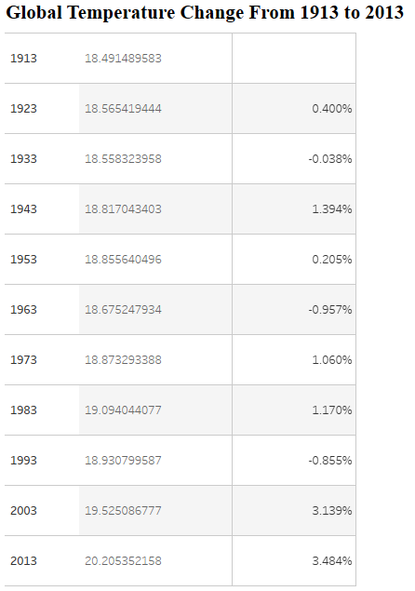
Analysis
Further analysis shows that the last two decades of data have shown the largest increases in temperature change.
Each of the last two decades of this century have seen greater than 3% increase from the previous 10 years!

Slide 7
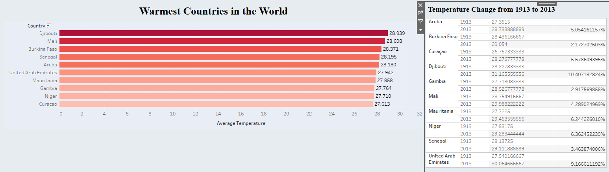
Analysis
Temperatures have risen at a slower rate in the warmest countries in the world, compared to the global average.

Slide 8
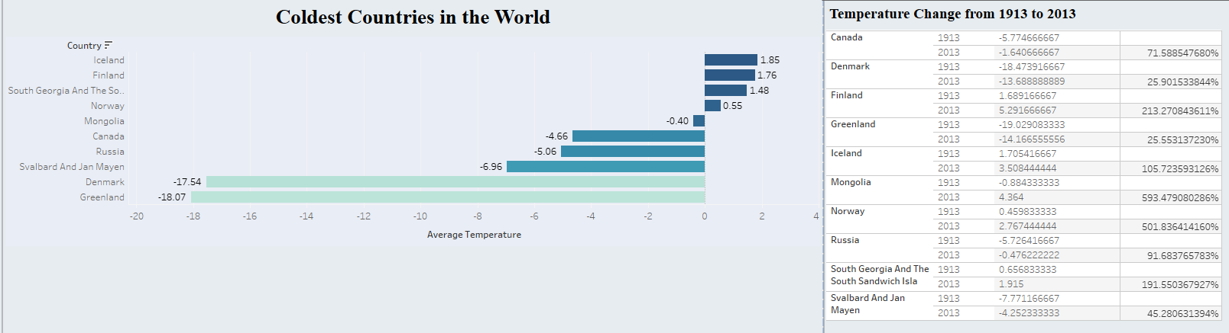
Analysis
Temperatures have risen at a higher rate in the coldest countries in the world, compared to the global average.

Slide 9
Takeaways
Global land temperature has increased by 9.268% from the years 1913 to 2013.
The warmest countries in the world are only seeing slight increases in temperature, while the coldest countries are seeing massive increases!
Climate change is in effect due to the rapid increase in global temperature.

Slide 10
Further Research - Questions to consider
What have been the major contributors to this rise in temperature?
How can awareness best be spread about this rise in temperature, and which areas of the world are likely to see the largest impact in day to day lifestyle?
What should the priorities be on the human agenda to address rising temperatures?

